Slide 1
Data 1 Advanced Design Scripting & Parametrics

Slide 2
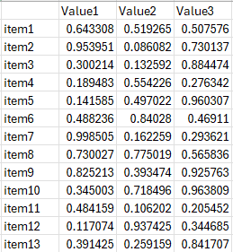
Structured / tabular vs unstructured data
Structured / tabular
Structured / tabular
[ // An Array
{
"Key 1": "Object 1",
"Key 2": "Value 1"
},
{
"Key 1": "Object 2",
},
{
"Key 2": "Value 3",
"Key 1": "Object 3",
"Key 3": "Value 4" // Flexible
}
]

Slide 3
Structured Data
Sometimes data associated with instances is consistent across similar instances. This sort of data is (somewhat erroneously) called “structured data” or “tabular data”, and we can represent it in a table, where
- Rows are individual data instances
- columns are the different (but consistent) key – value combinations:
Sometimes a specific parameter is identified as the ID of the instance. In that case this value must be unique for each instance:
ID | brand | model | year
00001 | Ford | Mustang | 1964
00002 | Ford | Mustang | 1967
00003 | BMW | I5 | 2022
00004 | BMW | I3 | 2024
00005 | Volkswagen | Rabbit | 1990
This is equivalent to - but not the same as - the following
[
{
ID : 00001,
brand: “Ford”,
model: “Mustang”,
year: 1964
},
{
ID : 00002,
brand: “Ford”,
model: “Mustang”,
year: 1967
},
. . .

Slide 4
Tabular data - serialization
Tabular data can be “serialized” as text with defined character separators between fields.
Serialize (roughly) write data out to a string or stream
This example:
ID | brand | model | year
00001 | Ford |  | 1964
00003 | BMW | I5 | 2022
00005 | Volkswagen | Rabbit | 1990
Could be serialized as follows:
ID,brand,model,year\n00001,Ford,,1964\n
00003,BMW,I5,2022 <cr>
00005,Volkswagen,Rabbit,1990 <cr>
This serialization has commas between fields and is known as CSV (comma separated value) format.

Slide 5
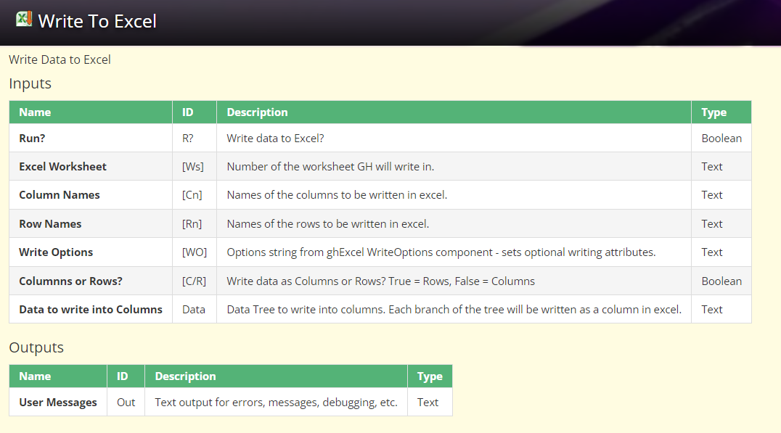
Saving data out to a file
Many options:
TTToolbox to Excel

Slide 6
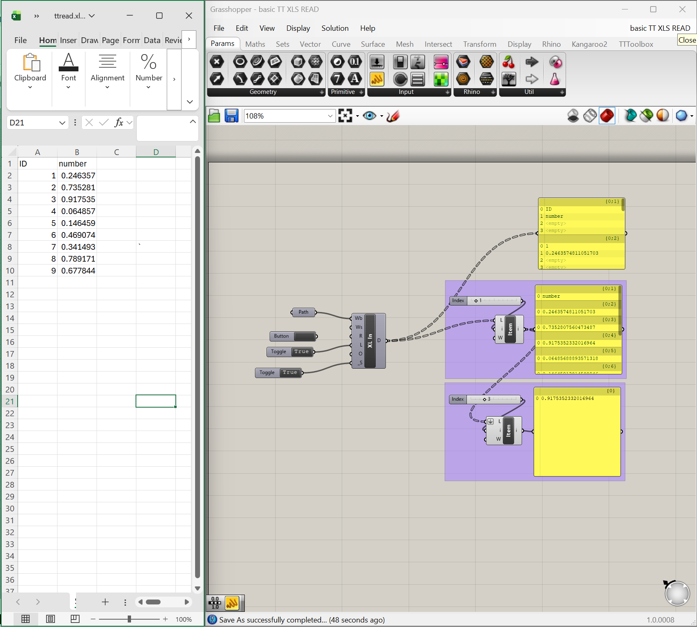
Saving data out to a file TTOOLBOX basic TT XLS READ.gh

Slide 7
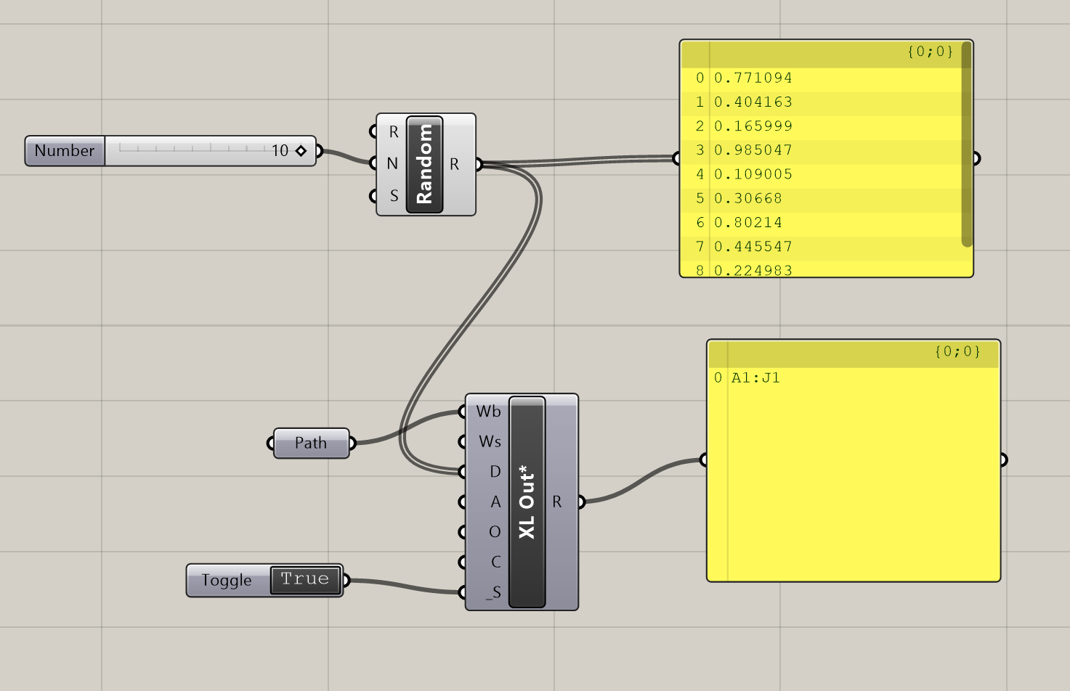
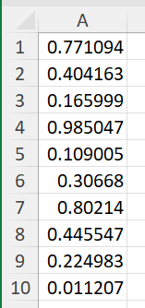
Saving data out to a file TTOOLBOX basic TT XLS READ.gh

Slide 8
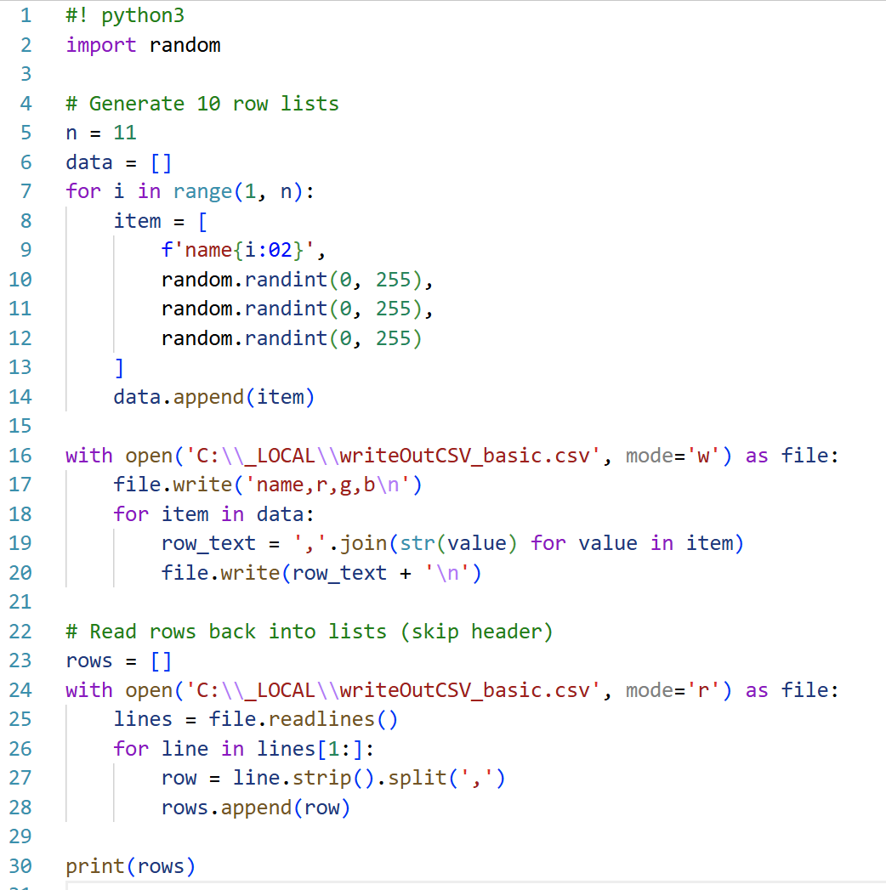
Saving data out to a file writeOutCSV_basic.py

Slide 9
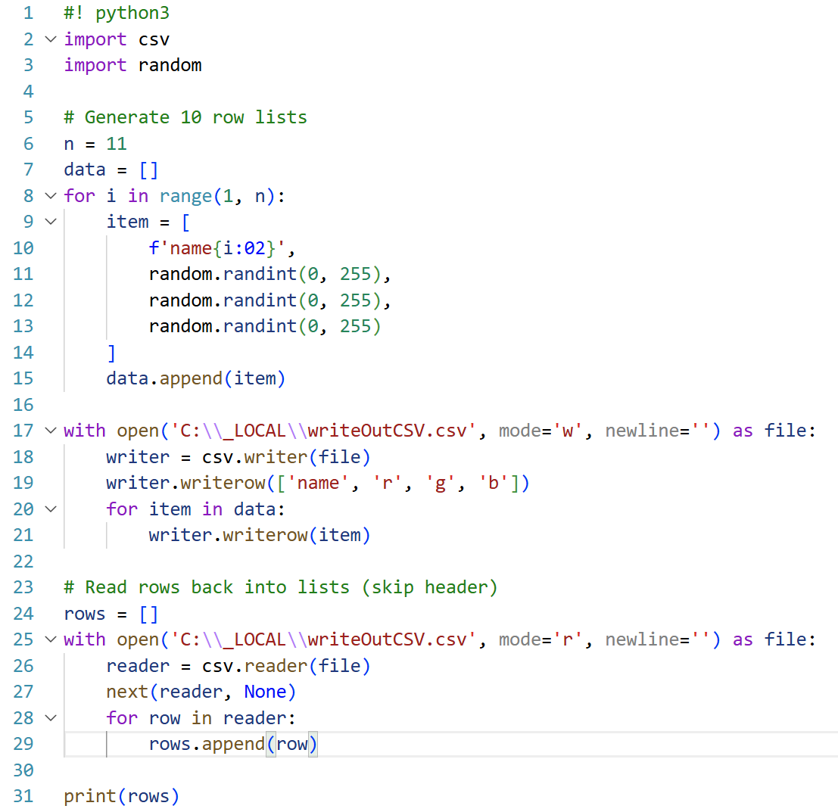
Saving data out to a file writeOutCSV.py
Many options:
With a simple file save

Slide 10
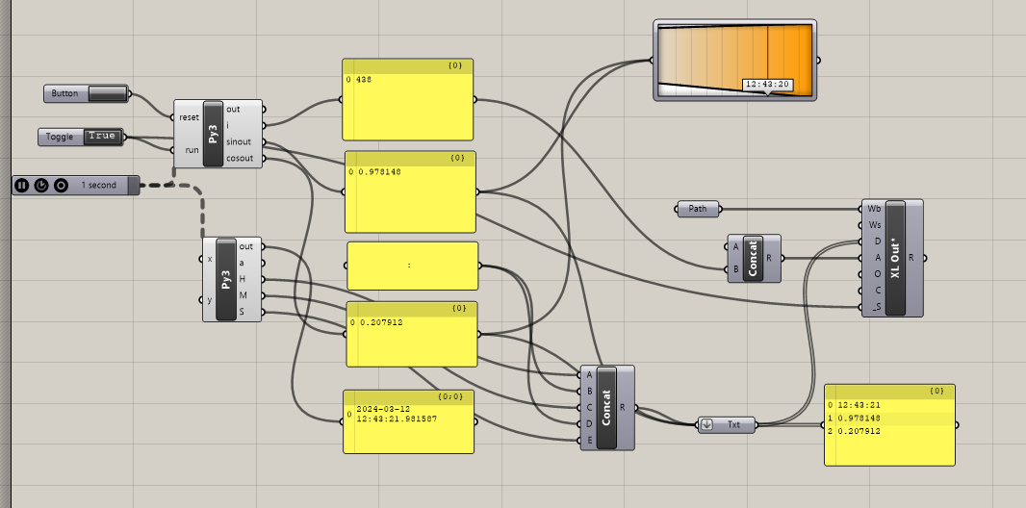
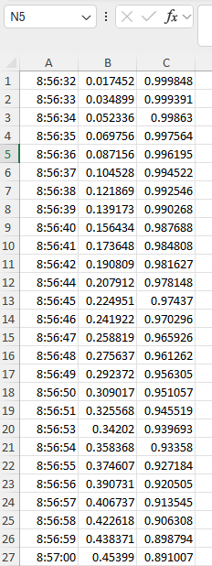
Data logging example
data logging.gh

Slide 11
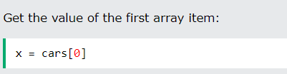


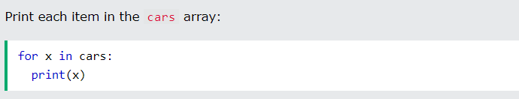
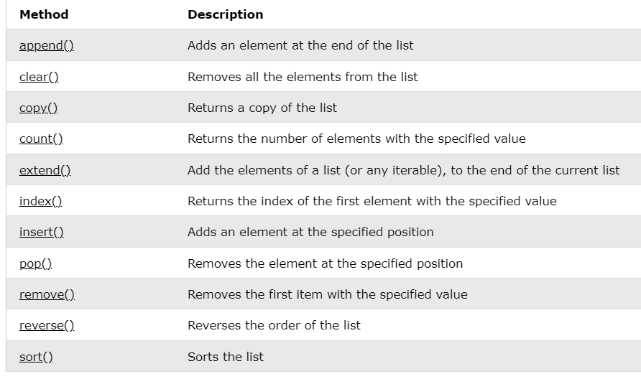
Accessing arrays (see w3c Python Arrays)

